Slide 1

Pothole Detection using YOLOv5
Name: Dhrumil Shah
Campus ID: 027972839

Slide 2
Introduction

Slide 3
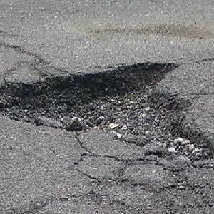
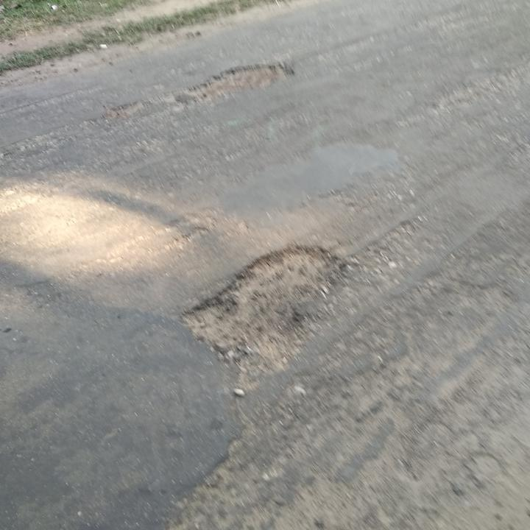
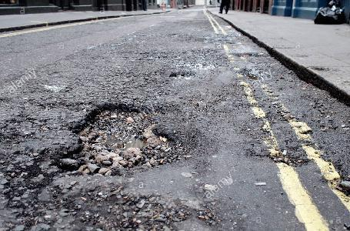
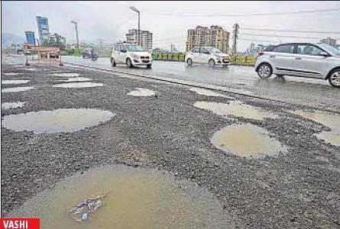
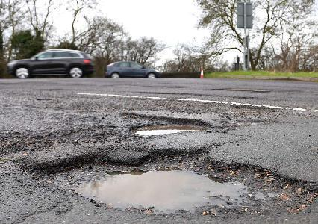

Slide 4
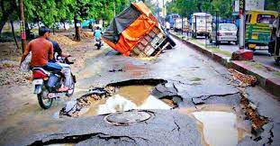
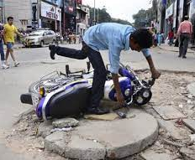
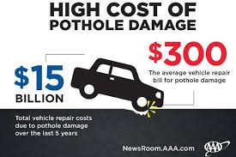
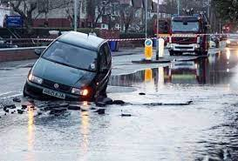

Slide 5
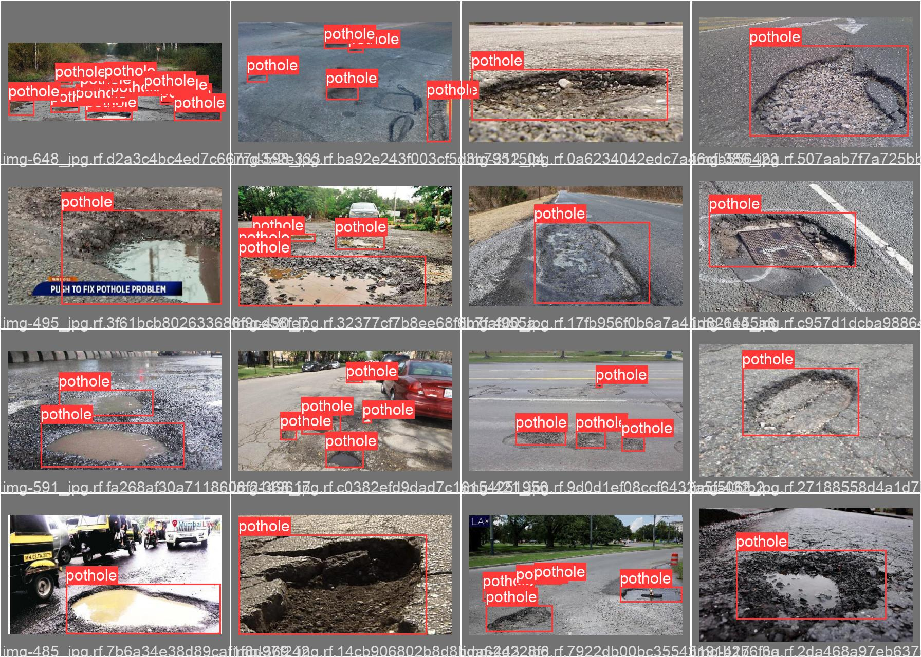

Slide 6
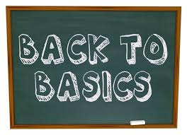

Slide 7
Image Classification
Image Localization
Object Detection
Image Segmentation

Slide 8
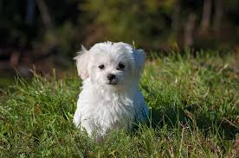
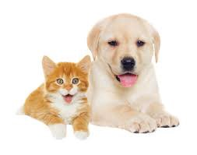
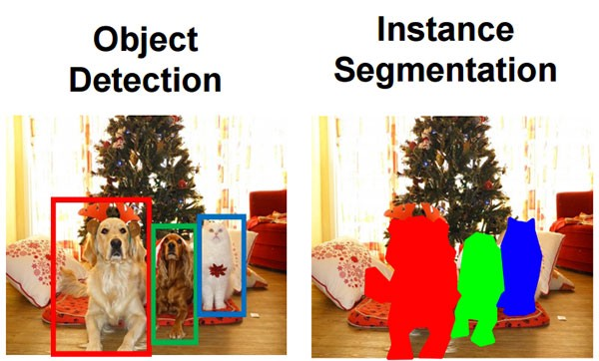
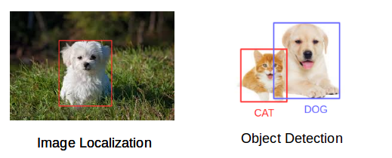

Slide 9
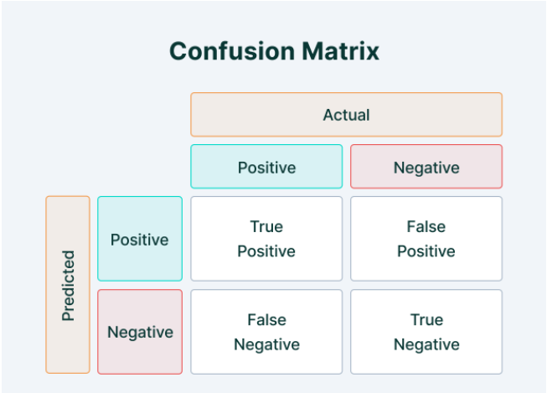

Slide 10
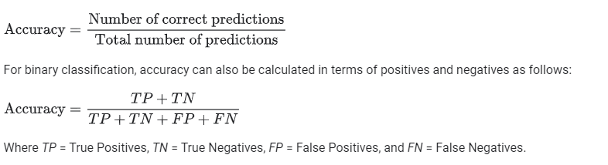
Accuracy

Slide 11
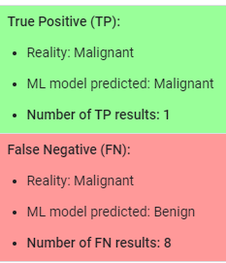
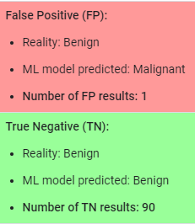
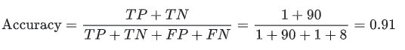
Let's try calculating accuracy for the following model that classified 100 tumors as malignant (the positive class) or benign (the negative class):

Slide 12
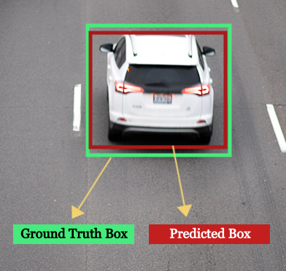
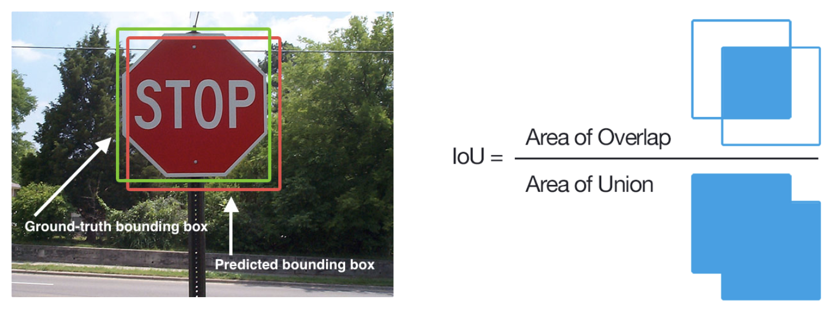
Intersection Over Union (IoU)

Slide 13
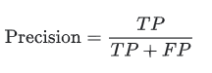
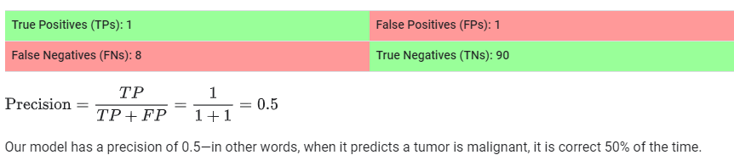
Precision
The proportion of true positives among all positive identifications

Slide 14
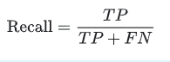
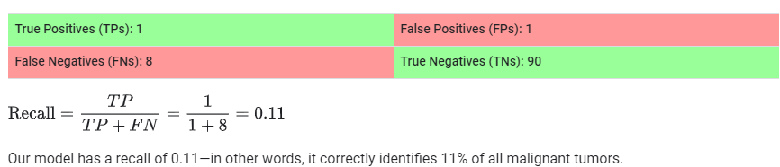
Recall
What proportion of actual positives was identified correctly ?

Slide 15
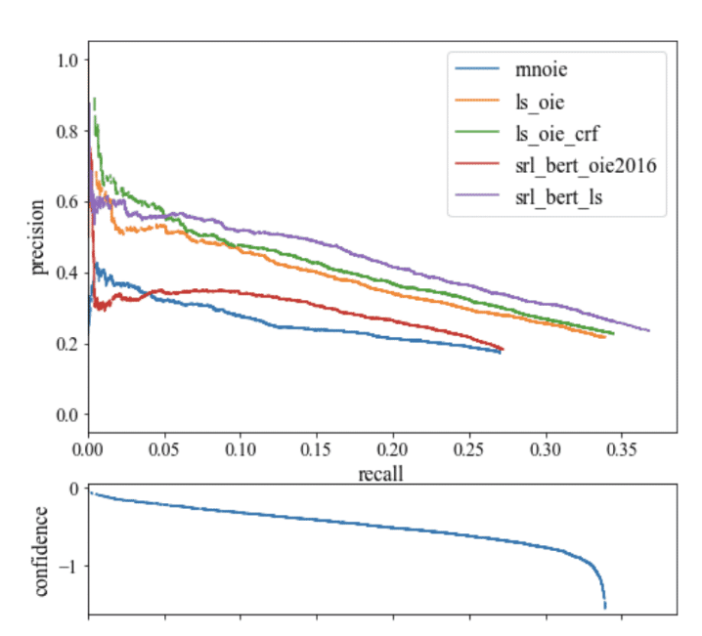
The process of plotting the model's precision and recall as a function of the model's confidence threshold is the precision recall curve.
It is downward sloping because as confidence is decreased, more predictions are made (helping recall) and less precise predictions are made (hurting precision)

Slide 16
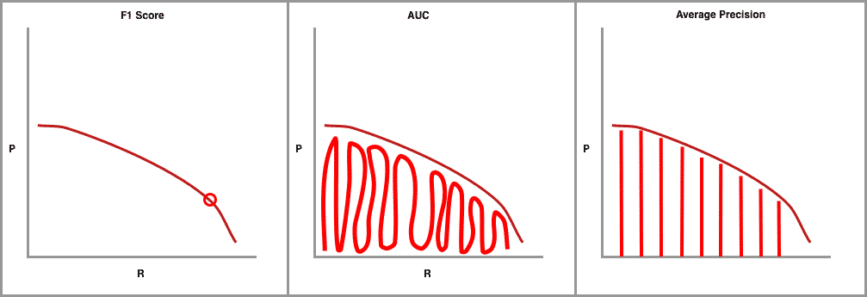
F1 score combines precision and recall measures to find the optimal confidence threshold where precision and recall produce the highest F1 value.
The F1 score calculates the balance between precision and recall
AUC (Area Under the Curve) integrates the amount of the plot that falls underneath the precision and recall curve.

Slide 17


Slide 18
YOLOv5 is an increment to YOLOv4. At present YOLOv5 based on PyTorch is the latest version of YOLO for object detection.
Also, YOLOv5 is still in development phase and has no official research paper on internet by Ultralytics.
YOLO v5 is a single-stage object detector comprising of three important components

Slide 19
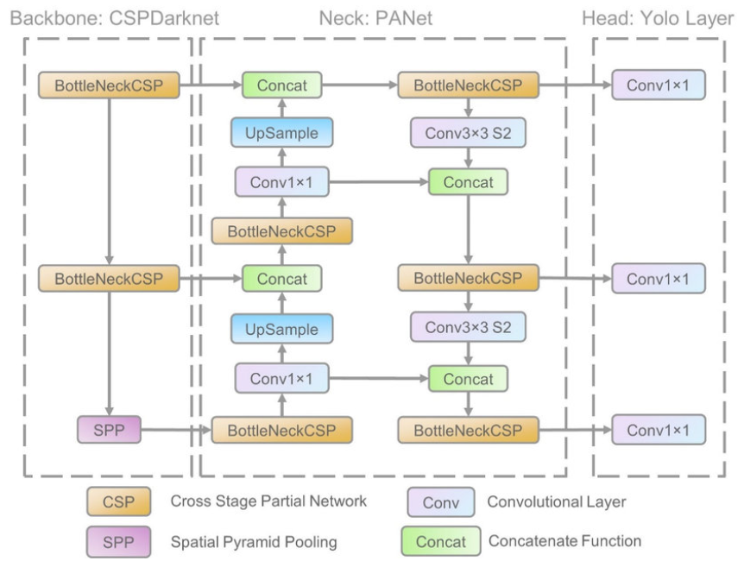

Slide 20
The data are first input to Cross Stage Partial Networks (CSPNet) incorporated into Darknet resulting into CSPDarknet for feature extraction, and then fed to Path Aggregation Network (PANet) for feature fusion. In the final stage, Yolo Layer outputs detection results (class, score, location, size).
1. Model Backbone - used to extract key features from the input image. In YOLO v5 the Cross Stage Partial Networks (CSPNet implemented using Darknet framework forming CSPDarknet) used as a model backbone to extract informative features from an input image. CSPDarknet has shown significant improvement in processing time with deeper networks.
2. Model Neck - used to generate feature pyramids that help models to generalize well on object scaling (i.e., to identify the same object with varied sizes and scales). Feature pyramids are very useful and help models to perform well on unseen data. In YOLO v5 Path Aggregation Network (PANet) is used as neck to get feature pyramids.
3. Model Head -The final stage is object detection is done with Model Head which happens to be same as v3 and v4 (i.e., YOLO layer) by applying anchor boxes on features and generating 3 final output vectors
• class probabilities
• objectness scores
• bounding boxes

Slide 22
Bag of Freebies (BoF) - The collection of methods that change the strategy or cost of training to improve model accuracy is Bag of Freebies.
Data Augmentation
The methodology of increasing the variations in the input data (images), to improve the robustness of the object detection model for the images from multiple environments.

Slide 23
Photometric Distortions – involves manipulation of Brightness, Contrast, Hue, Saturation, Noise
• Geometric Distortions - involves random scaling, cropping, flipping, and rotation
• Random Erase and Cut Out: random selection of rectangular region in the image and fill in a random or complementary value of zero.
• Hide-and-Seek and Grid Mask: random or even selection of multiple rectangular regions in an image and replacing them to all zeros.
• MixUp: Uses two images to multiply and superimpose with different coefficient ratios, and then adjusts the label with these superimposed ratios.
• CutMix: The process of covering the rectangular region of Images with the other cropped images and then adjusting the label in accordance with the size of mix area.

Slide 24
Bag of Specials (BoS) - Bag of Specials comprises of different plugins and the post-processing modules that only increase the inference cost by a small amount but can drastically improve the accuracy of the object detector.

Slide 25

Experiment

Slide 26
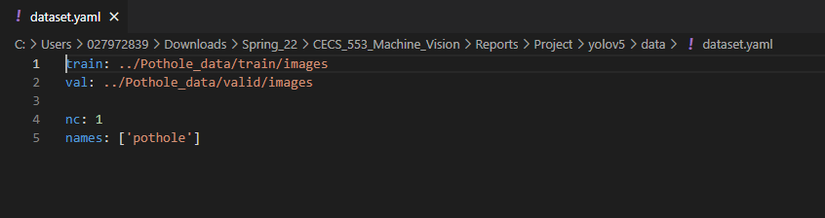
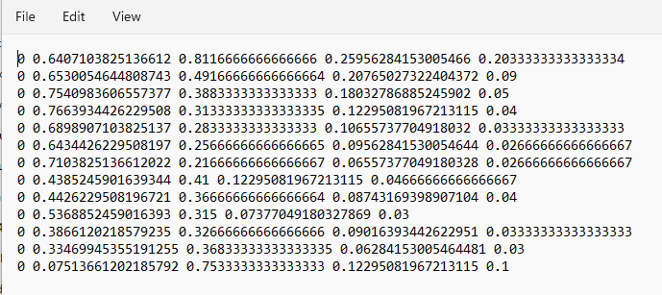
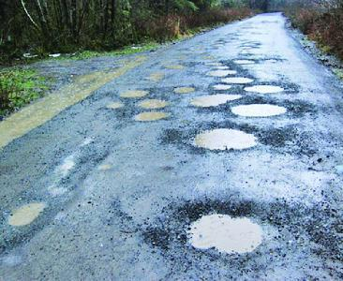

Slide 27
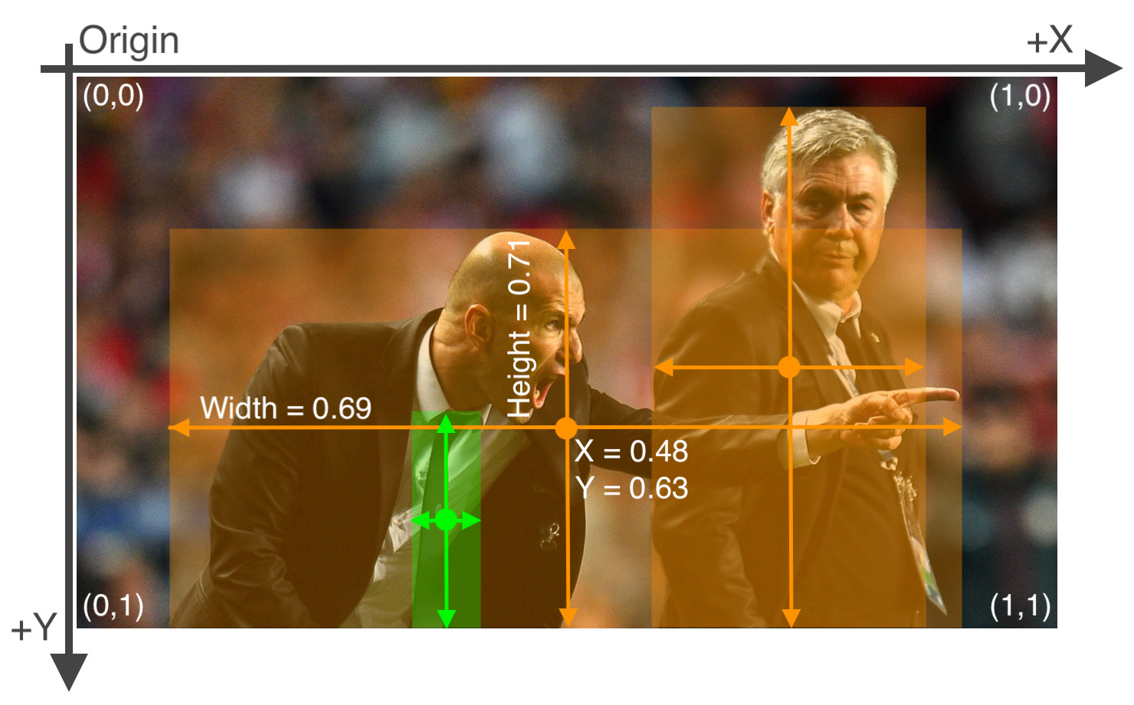
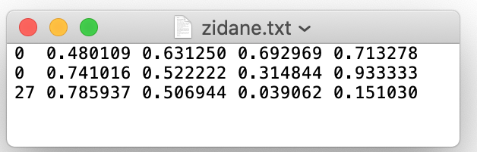
Labels
.txt-file for each .jpg -image-file - in the same directory and with the same name, but with .txt-extension,
One row per object
Each row is <class> <x_center> <y_center> <width> <height> format.
Box coordinates must be in normalized xywh format (from 0 - 1). If your boxes are in pixels, divide x_center and width by image width, and y_center and height by image height.
Class numbers are zero-indexed (start from 0).
The label file corresponding to the above image contains 2 persons (class 0) and a tie (class 27):

Slide 29
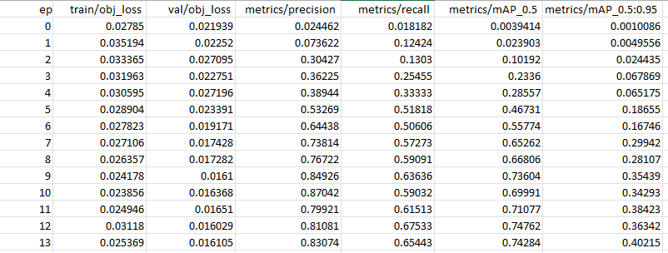
Results for YOLOv5s, Epochs - 30, Batch Size - 16, Image size – 416

Slide 30
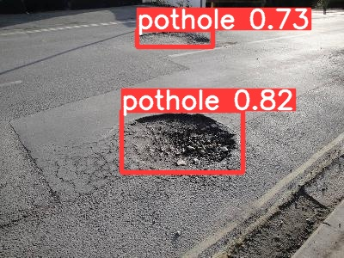
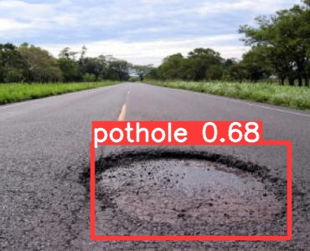
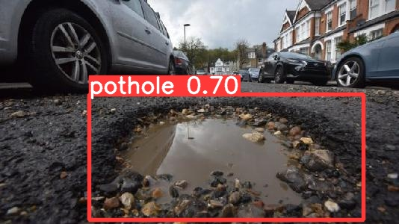

Slide 31


